Slide 1

Web Development (HS1074)
FY- SEM I- 2024-2025
Mid-Sem REVIEW
CLASS – CS-CBI-B BATCH - 01 GROUP No.- 02 Project Title – MINISTRY OF Education
Presented By - Roll No. Project Guide – Hon. MS. JAYASHREE BAGADE MA’AM
1) Atharva Kale 07
2) Rushabh Kalme 08
3) Snehal Kandekar 09
4) Sahil Karmankar 10
5) Rohan Katti 11
6) Narendra Kavhat 12

Slide 2
HTML Structure Tags:
<!DOCTYPE html>: Declares the document type and version (HTML5 in this case).
<html>: The root element of the HTML document.
<head>: Contains meta-information about the document, such as character encoding, viewport settings, title, and internal styles.
<meta>: Provides metadata about the HTML document, such as character set and viewport settings.
<title>: Specifies the title of the document (appears in the browser tab).
<style>: Contains internal CSS styles for the page layout and appearance.
<body>: Contains the content of the document visible to the user.

Slide 3
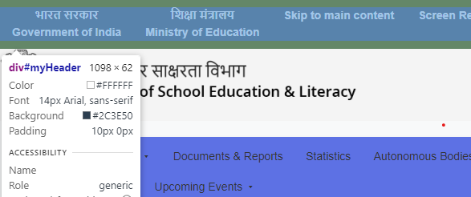
Header Section:
<header>: Defines the header section of the page.
<h1>: Defines a top-level heading. It includes an image (logo) and text.
<img>: Embeds an image within the heading section.
src specifies the image URL.
alt provides alternative text for the image.
width and height set the image dimensions.
<nav>: Defines a navigation section, typically containing
links to different sections of the website.
<a>: Defines hyperlinks.
href attribute specifies the target URL.
target="_blank" in some links opens the linked
document in a new tab.

Slide 4

Main Content Section:
<div>: A generic container for grouping content, used to structure different sections.
id attribute is used to target specific sections for styling
or scripting.
<h2>: Defines a second-level heading.
<p>: Defines a paragraph of text.
<br>: Inserts a line break between text or elements.
<strong>: Makes the enclosed text bold (often used for
emphasis).
<ul>: Defines an unordered list.
<li>: Defines list items in an unordered list.
<img>: Multiple images are embedded within the content with width and height attributes to control size.

Slide 5
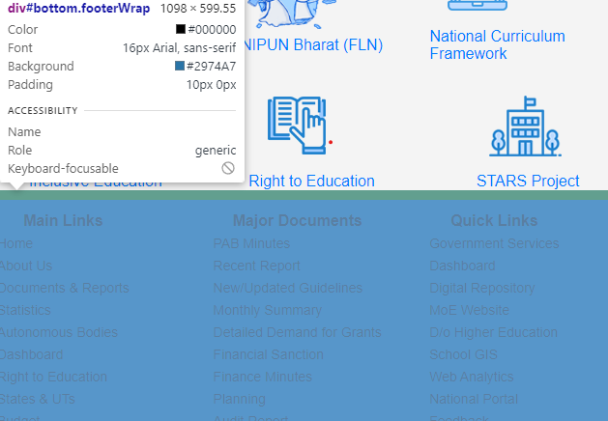
Footer Section:
<footer>: Defines the footer of the document
, typically containing copyright and additional
information.
&copy;: HTML entity for the copyright symbol.
External Resources:
<iframe>: Embeds an external resource, in this case,
a YouTube video.
src specifies the URL of the embedded content.
allow="autoplay; encrypted-media" allows specific features like autoplay and media encryption.
allowfullscreen enables fullscreen mode for the video

Slide 6
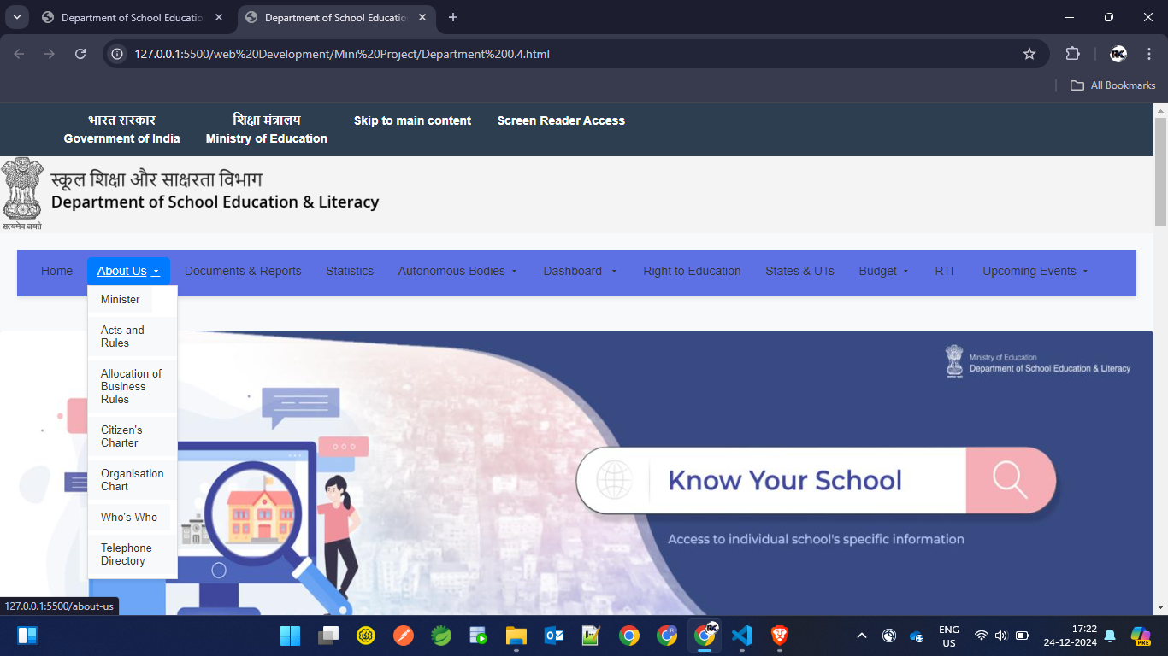
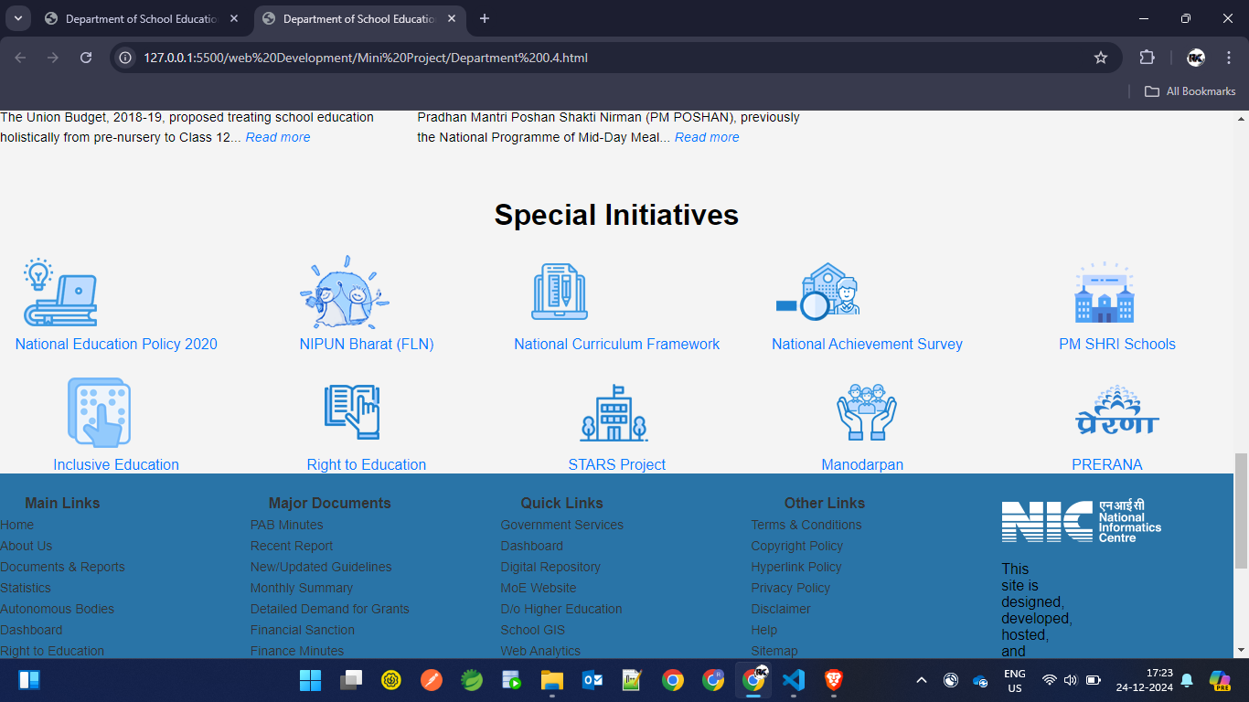
HTML and CSS used for Page Design

Slide 7
CSS attributes (properties)
flex | Defines how flex items grow, shrink, or maintain space within a flex container. Used for responsive layouts.
display | Controls the layout behavior of an element (e.g., block, flex, grid, inline-block).
list-style | Removes or customizes bullets/numbers for list items.
line-height | Controls the vertical spacing between lines of text. Enhances text readability.
font-weight | Specifies the boldness of text. Highlights or emphasizes important text.
background-color | Sets the background color of an element. Used to improve visibility and aesthetic appeal.
border-radius | Rounds the corners of an element. Gives a softer appearance to boxes or images.
text-decoration | Modifies text appearance, such as removing underlines from links.
border | Creates a visible line around an element. Enhances visual separation or focus.

Slide 8
padding | Adds space inside the element's border. Used for proper spacing and visual alignment.
font-size | Sets the size of the text. Improves legibility and responsiveness.
font-family | Defines the font style for text. Ensures consistency and readability.
color | Specifies the text color. Improves readability and ensures contrast with the background.
media | Creates breakpoints for responsive design. Ensures proper layout on different screen sizes.
hover | Defines styles when the user hovers over an element. Improves interactivity.
gap | Adds space between rows and columns in a flex or grid container.
grid-gap | Specifies space between grid items. Ensures a clean, spaced grid design.

Slide 9
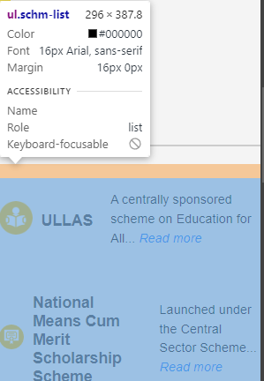
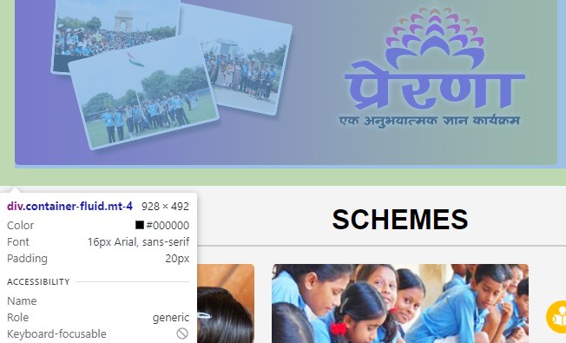
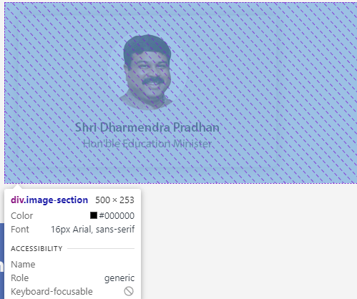
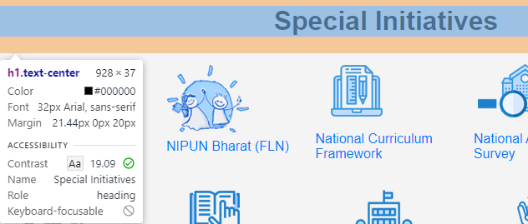

Slide 10
outline | Adds a border outside the element's edge, often used for accessibility focus.
grid-template-columns | Defines the column structure in a grid layout. Allows responsive and organized layouts.
box-shadow | Adds a shadow effect to an element. Provides depth and visual separation.
outline-offset | Sets space between the outline and the element's border. Enhances focus visibility.
object-fit | Specifies how images or videos fit within a container (e.g., cover, contain).
width, height | Sets fixed dimensions for an element. Ensures consistent sizing.
transform | Applies transformations such as scaling, rotating, or translating an element.
cursor | Changes the cursor's appearance (e.g., pointer for links).
transition | Adds animation effects between states (e.g., hover effects).

Slide 11
max-width, max-height | Sets the maximum width/height of an element. Ensures elements don't grow too large on wider screens.
overflow | Defines how content that exceeds an element's size is handled (e.g., hidden, scroll).
z-index | Controls the stack order of elements. Higher values appear on top of lower values.
top, left, right, bottom | Specifies offset values for positioned elements. Places elements at specific locations.
justify-content | Aligns flex items horizontally. Commonly used for center or space-between alignment in Flexbox.
position | Specifies how an element is positioned in the document (e.g., relative, absolute, fixed).
align-items | Aligns flex items vertically in a Flexbox container.
margin | Adds space outside the element. Used to maintain consistent spacing between elements.

Slide 12
HTML Form Attributes in JAVASCRIPT
Attribute | Purpose
name | Assigns a name to form inputs for easier data handling.
id | Provides unique identifiers for form elements (e.g., id="name", id="email") to reference them in JavaScript.
onsubmit | Triggers the JavaScript validateForm function when the form is submitted. Prevents submission if validation fails.
required | Ensures that specific fields must be filled before the form can be submitted.

Slide 13
JavaScript Functions & Attributes
return | Stops further execution of the onsubmit function if validation fails (returns false).
alert() | Displays a browser alert with a message to the user. Used here to confirm form submission success.
setTimeout() | Delays the execution of a function by a specified number of milliseconds. Used for redirection after form submission.
document.getElementById | Fetches the DOM element by its unique id. Used to get input values and manipulate error message fields.
.innerText | Sets or gets the text content of an element. Used here to display error messages.
.value | Retrieves the current value entered into an input field.
.test() | Tests a string against a regular expression. Used to validate email and phone number formats.
.trim() | Removes whitespace from the beginning and end of a string. Helps validate empty input fields.

Slide 14
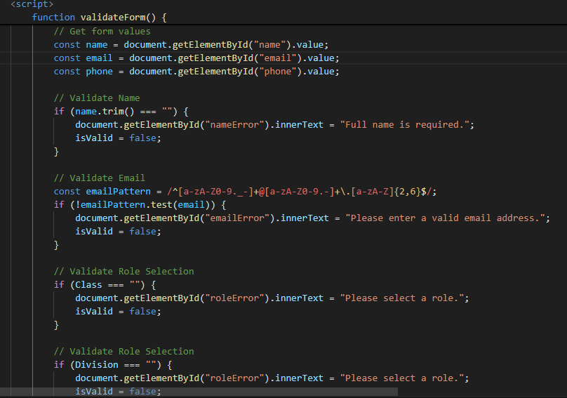
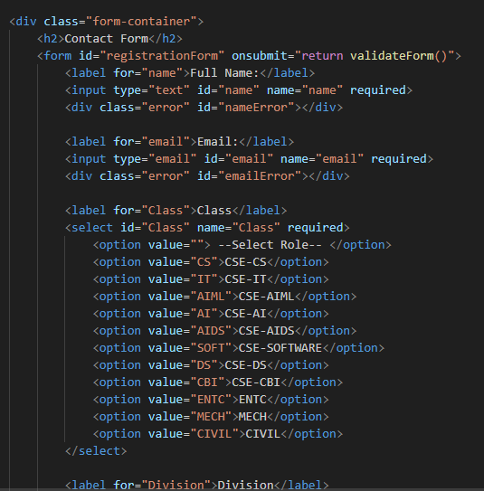
JAVASCRIPT in Validation Form

Slide 15
JavaScript Validation Logic
Phone Number Validation | Ensures the input matches a 10-digit number using regex (phonePattern). Displays an error if invalid.
Form Submission | Prevents form submission if any validation fails. Otherwise, shows success message and redirects.
Email Validation | Uses a regex (emailPattern) to ensure the input matches a valid email format. Displays an error if invalid.
Name Validation | Checks if the name input is empty after trimming whitespace. Displays an error if invalid.
Dropdown Validation | Checks if a value is selected in dropdowns (Class, Division, year). Displays an error if invalid.

Slide 16
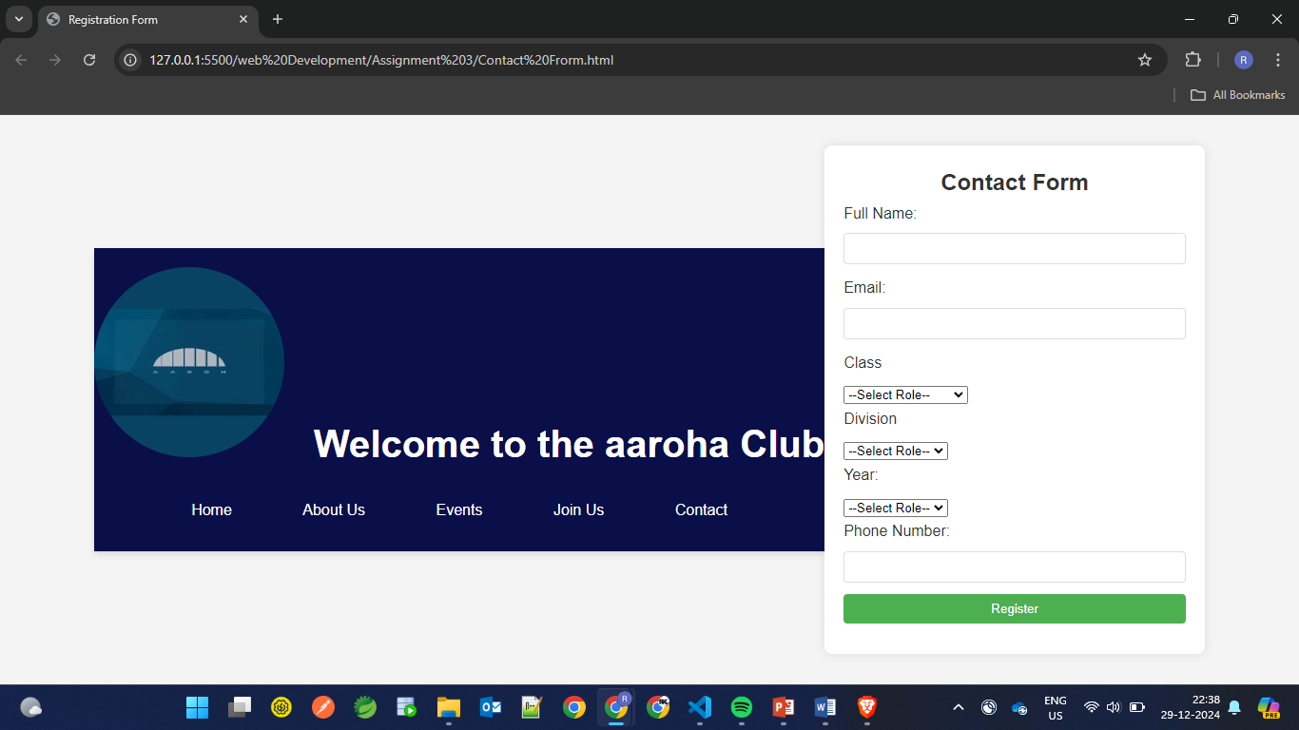
JavaScript for FormValidation and SlideShow

Slide 17
Thank You

